Slide 1


2048 GAME

Slide 2

01
The team
02
The Task
Table of contents
03
Technologies

Slide 3
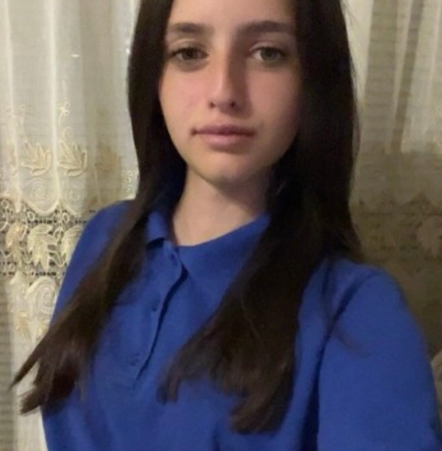
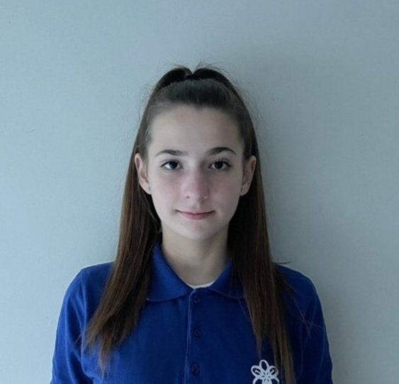
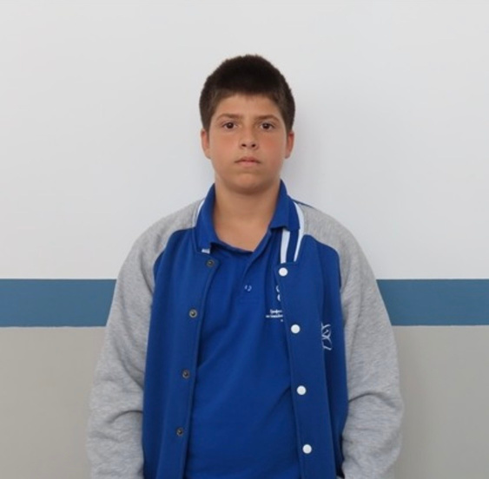
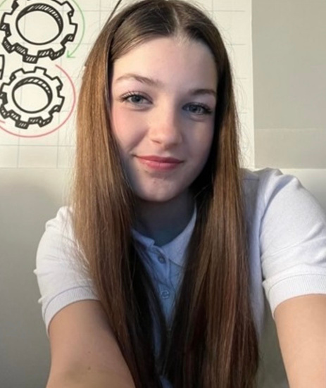
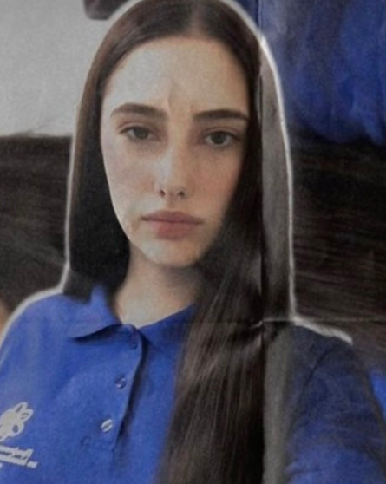
Our Team
Beloslava Ileva 9g
Gabriela Badalova 9b
Kaloyan Kolev 9a
Emanuela Mancheva 9a
Irina Dimova 9a
Scum trainer
Front - End Developer
Back - End Developer
Designer

Slide 4
The Task
We created this game for you to play it in your free time. The idea of the game is to be fun but also to improve your logical thinking. Use your arrow keys to move the tiles. When two tiles with the same number touch, they merge into one. Once you get 2048 in any square, you win.

Slide 5









Technologies

Slide 6
Now let's take a look!

